Slide 1
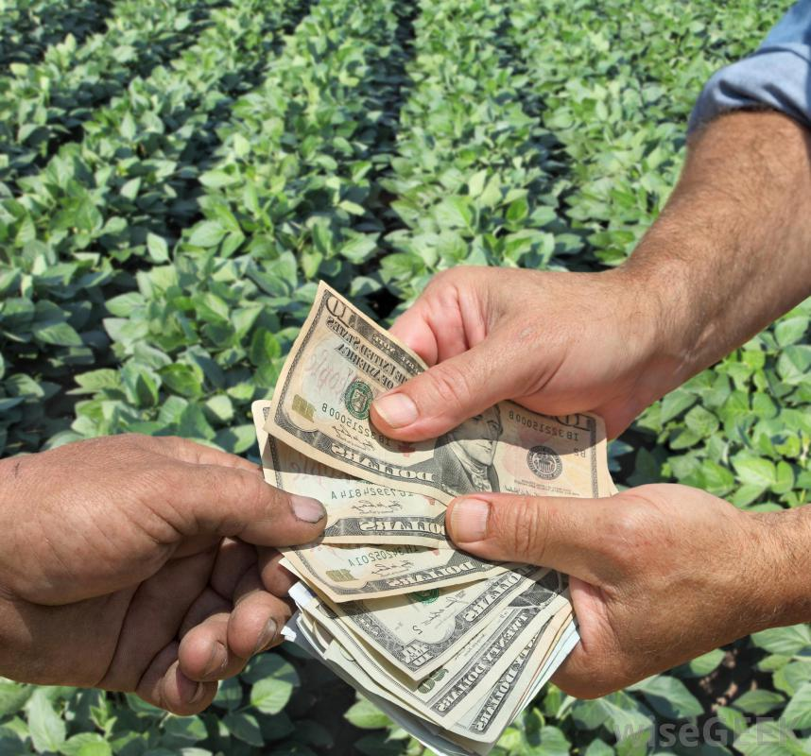
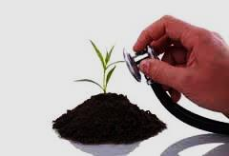
Soil Health
Bhu-Niraamaya: from soil Health to Farmers’ Wealth

Slide 2
Problems
Farmers are not showing interest in soil testing because it is
Time consuming
Cumbersome
Not easy to understand the reports.
The results are delayed i.e. results to the farmers does not reach in time.
Lesser number of soil test laboratories.

Slide 3
Solution
Novel Interactive App and Architecture for Soil Sample Collection and Mapping using GPS.
We can keep a mobile vehicle which goes to the farm equipped with a soil sample collector and GPS.
Then we can give the detailed reports of the test to respective farm owners with a map fertilizer distribution.

Slide 4

Business Model
Per unit Revenue
Rs.150/test
Marketing
Dealing with progressive farmers and Sarpanch
Result demonstration
Partnership
Input dealers and distributers
Private and cooperative banks
Insurance companies
USP
App linked soil test and follow up
Door to door access
Recommendations as per cropping methodologies

Slide 5
USP
Less time consuming with detailed analysis
App linked soil test and follow up
Door to Door access

Slide 6
How to reach the customers?
Creating confidence among village leaders
Wallet point earning provision for the customers
Agri Fairs, retail shops,
Provision of incentives on first come customers

Slide 7
Source of revenue
Expense outlets
Soil test fee from farmers
Advertisements on app
Commission from dealers and retailers
Non-Recurring cost
Utility Van and Testing equipment
App developing cost
Variable cost
Office Rent
Salary of Employees
Cost of Inventory
Miscellaneous expenses

Slide 8
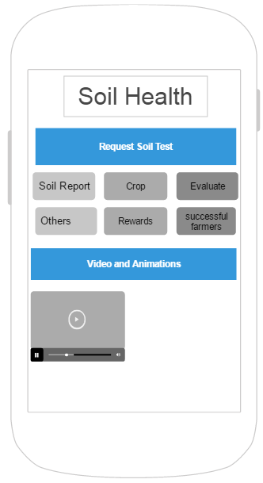
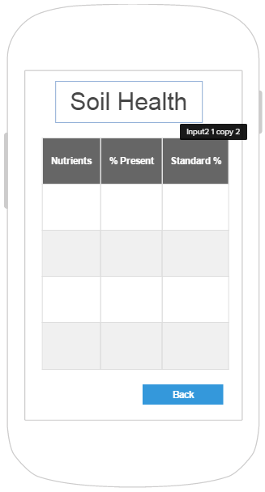
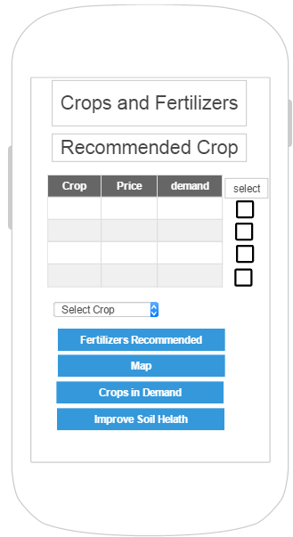
App UI

Slide 9
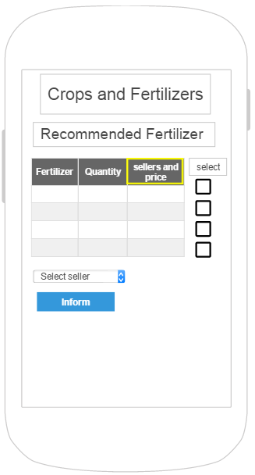
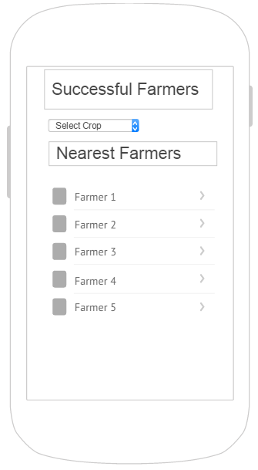
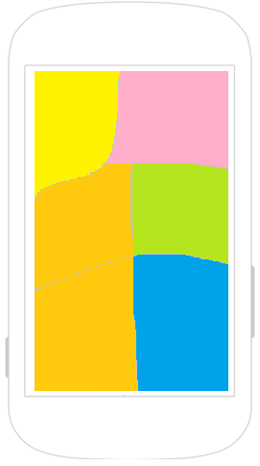
App UI

Slide 10
Future Prospects
Linking of crop data and soil data for more accuracy.
Data sharing for monetary benefits.
Inclusion of drone for sample collection to save travel time.
Entering in dealership of agrochemicals and seeds

